Slide 1
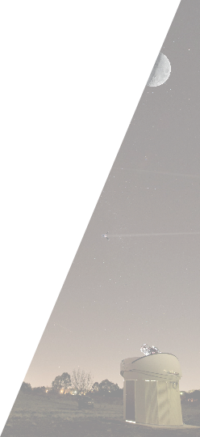

ZEIT 4507: Space Situational Awareness
Lecture 14: Sequential Estimation
School of Engineering and Information Technology
Steve Gehly (s.gehly@adfa.edu.au)
Melrose Brown (melrose.brown@adfa.edu.au)
Andrew Lambert (a-lambert@adfa.edu.au

Slide 2

Learning Objectives
Topics of Study
Overview of orbital mechanics and perturbations
Debris sources, distribution, and evolution in time
Contemporary debris analysis software tools
Analysis of collision probabilities and mitigation strategies
Effects of space environment on debris
Role of policy in sustainability of future space operations
Learning Outcomes
Define the primary sources and distribution of debris in Earth orbit
Compute and analyse evolution of the orbital debris population
Analyze ground-based sensor data for space object characterization
Understand the influence of the space environment on orbital debris
Appreciate the role of policy in ensuring the sustainability of future space operations
Understand the principle technical approaches involved in maintaining space situational awareness and ensuring sustainability of future space operations
Notes:
Challenges: Nose, signal cut due to boundray, Bias …

Slide 3
Course Schedule
Week | Monday (10:00-11:30) | Wednesday (11:00-12:30) | Tuesday Lab (16:00-18:00)
1 (13-Jul) | Overview of Debris Environment | Overview of the Debris Environment | MASTER Tutorial Session
2 (20-Jul) | Evolution Models | NewSpace, MegaConstellations | MASTER Working Session
3 (27-Jul) | Anomalies and Breakup Events | Mitigation and Remediation | MASTER Working Session
4 (03-Aug) | Space Environment (Melrose) | Space Policy and Law (Duncan Blake) | MASTER Working Session
5 (10-Aug) | Sensors (Andrew) | Sensors (Andrew) | MASTER Working Session
6 (17-Aug) | SACT | Military Training Day | SACT
7 (24-Aug) | Batch Estimation | Sequential Estimation | MASTER Lab Due
Mid-Semester Break
8 (14-Sept) | Sequential Estimation | Object Characterization (Quiz) | Falcon Working Session
9 (21-Sept) | Maneuver Detection | Conjunction Assessment (Quiz) | Falcon Working Session
10 (28-Sept) | Nonlinear Estimation | Initial Orbit Determination (Quiz) | Falcon Working Session
11 (05-Oct) | Labour Day | Data Association (Quiz) | Falcon Working Session
12 (12-Oct) | Multitarget Estimation | Sensor Management (Quiz) | Falcon Lab Report Due
13 (19-Oct) | Data Fusion | Final Presentations | Off
Unit 1: Debris Overview & Environment
Unit 2: Space Surveillance and Tracking
Unit 3: Advanced Space Surveillance and Tracking
Notes:
Challenges: Nose, signal cut due to boundray, Bias …

Slide 4
Orbit Determination

Slide 5
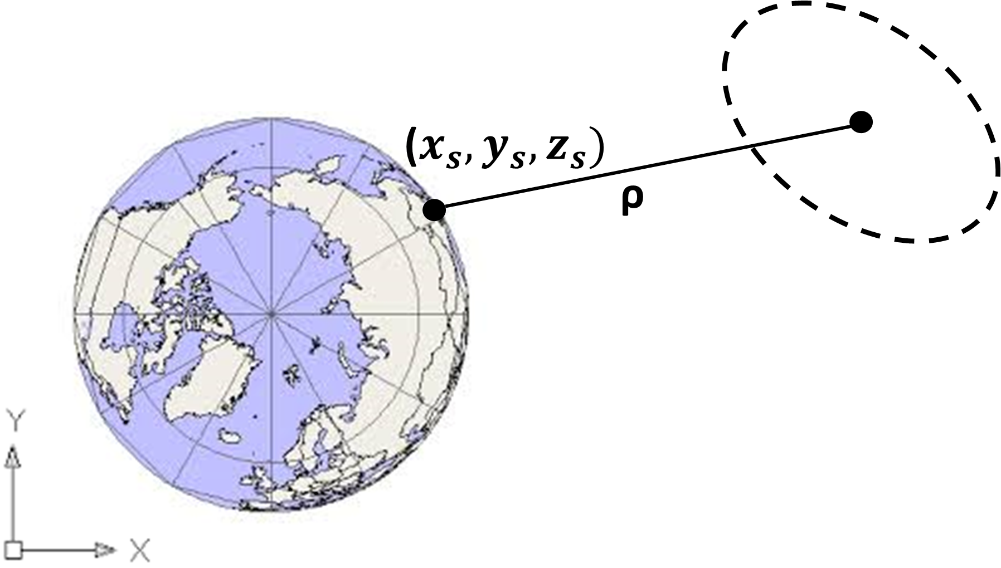
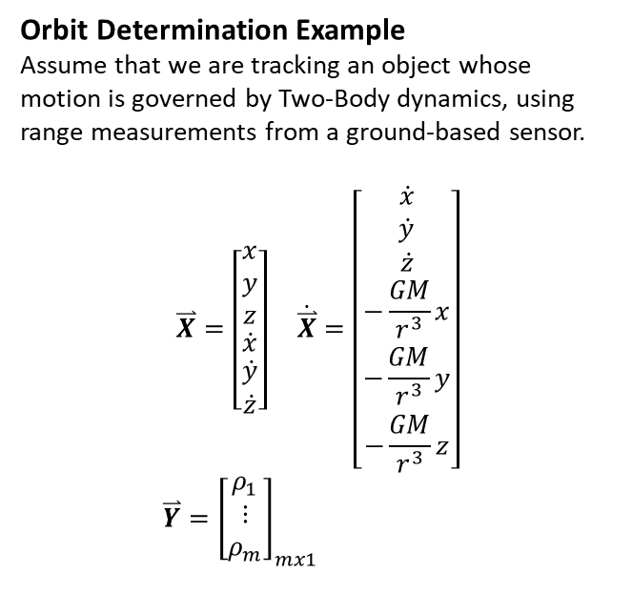
Orbit Determination Problem
The key challenge posed by applying least squares estimation to orbit determination is that both the dynamics and measurement equations are nonlinear. Batch Least Squares is designed for linear systems, so we will have to make some adjustments.
Orbit Determination Example
Assume that we are tracking an object whose motion is governed by Two-Body dynamics, using range measurements from a ground-based sensor.
$$\overset{⃑}{X}=\left[\begin{matrix}\begin{matrix}x \\ y \\ z\end{matrix} \\ \dot{x} \\ \begin{matrix}\dot{y} \\ \dot{z}\end{matrix}\end{matrix}\right] \dot{\overset{⃑}{X}}=\left[\begin{matrix}\begin{matrix}\dot{x} \\ \dot{y} \\ \dot{z}\end{matrix} \\ −\frac{GM}{r^{3}}x \\ \begin{matrix}−\frac{GM}{r^{3}}y \\ −\frac{GM}{r^{3}}z\end{matrix}\end{matrix}\right]$$
$\overset{⃑}{Y}={\left[\begin{matrix}ρ_{1} \\ ⋮ \\ ρ_{m}\end{matrix}\right]}_{mx1}$

Slide 6
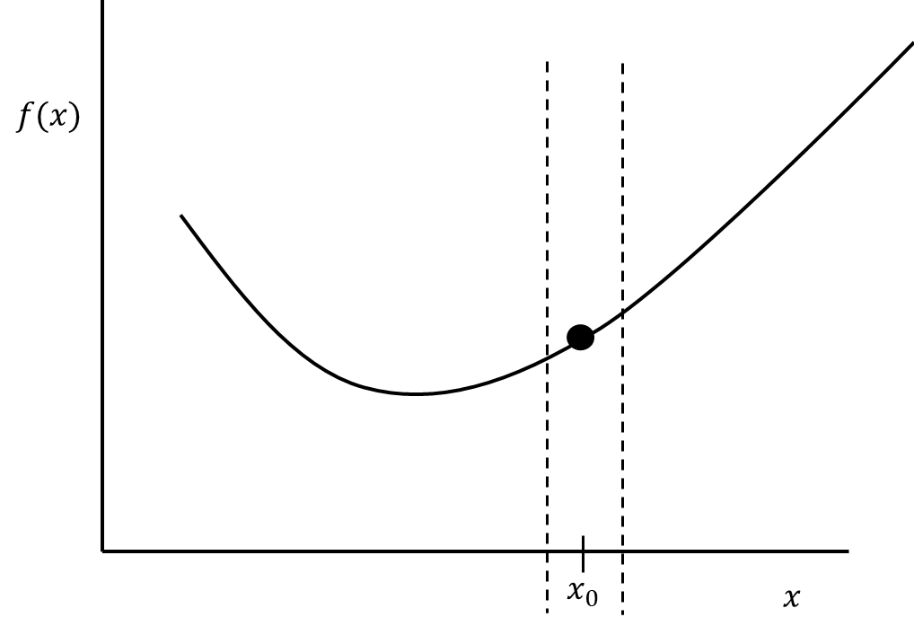
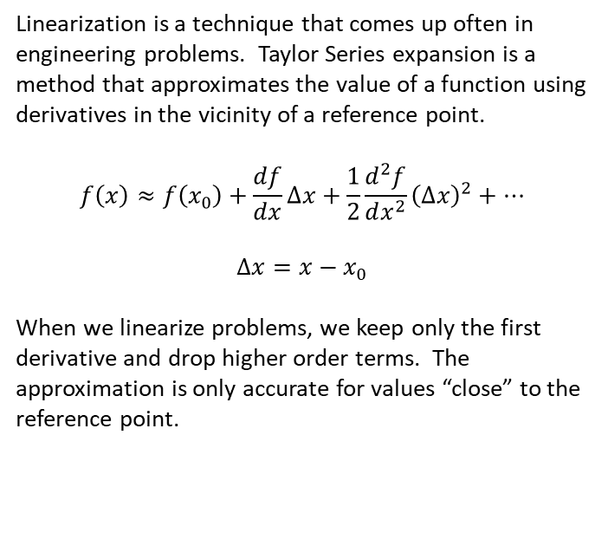
Taylor Series Expansion
Linearization is a technique that comes up often in engineering problems. Taylor Series expansion is a method that approximates the value of a function using derivatives in the vicinity of a reference point.
$$f\left(x\right)≈f\left(x_{0}\right)+\frac{df}{dx}∆x+\frac{1}{2}\frac{d^{2}f}{dx^{2}}{\left(∆x\right)}^{2}+…$$
$$∆x=x−x_{0}$$
When we linearize problems, we keep only the first derivative and drop higher order terms. The approximation is only accurate for values “close” to the reference point.

Slide 7
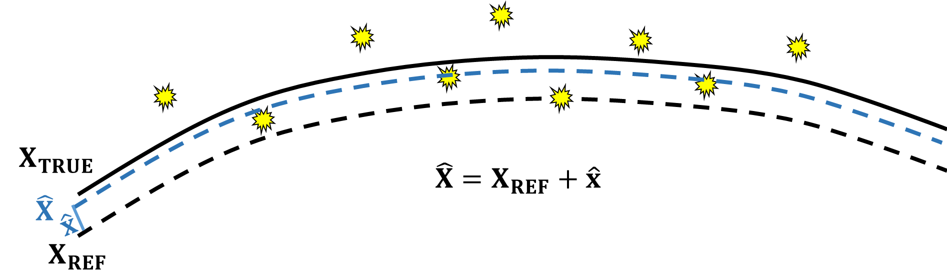
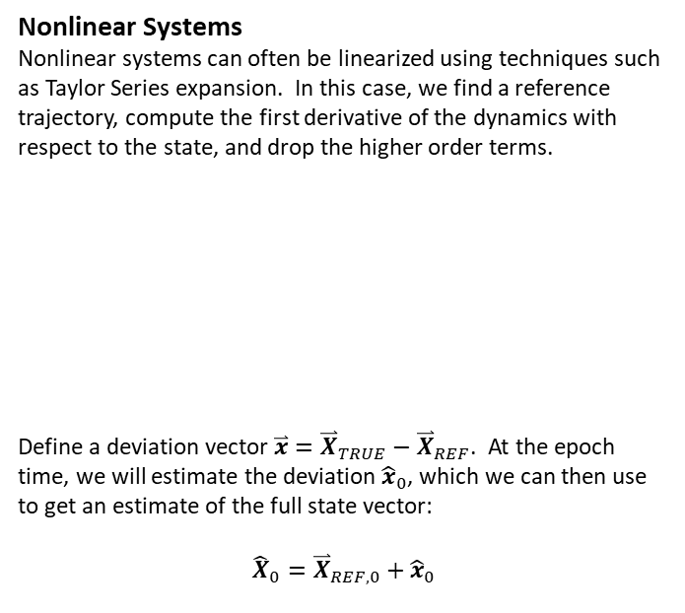
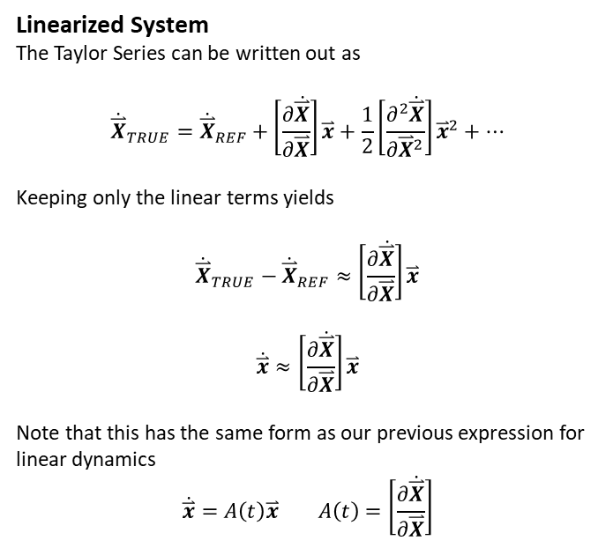
Dynamics Model
Nonlinear Systems
Nonlinear systems can often be linearized using techniques such as Taylor Series expansion. In this case, we find a reference trajectory, compute the first derivative of the dynamics with respect to the state, and drop the higher order terms.
Define a deviation vector $\overset{⃑}{x}={\overset{⃑}{X}}_{TRUE}−{\overset{⃑}{X}}_{REF}$. At the epoch time, we will estimate the deviation ${\hat{x}}_{0}$, which we can then use to get an estimate of the full state vector:
$${\hat{X}}_{0}={\overset{⃑}{X}}_{REF,0}+{\hat{x}}_{0}$$
Linearized System
The Taylor Series can be written out as
$${\dot{\overset{⃑}{X}}}_{TRUE}={\dot{\overset{⃑}{X}}}_{REF}+\left[\frac{∂\dot{\overset{⃑}{X}}}{∂\overset{⃑}{X}}\right]\overset{⃑}{x}+\frac{1}{2}\left[\frac{∂^{2}\dot{\overset{⃑}{X}}}{∂{\overset{⃑}{X}}^{2}}\right]{\overset{⃑}{x}}^{2}+…$$
Keeping only the linear terms yields
$${\dot{\overset{⃑}{X}}}_{TRUE}−{\dot{\overset{⃑}{X}}}_{REF}≈\left[\frac{∂\dot{\overset{⃑}{X}}}{∂\overset{⃑}{X}}\right]\overset{⃑}{x}$$
$$\dot{\overset{⃑}{x}}≈\left[\frac{∂\dot{\overset{⃑}{X}}}{∂\overset{⃑}{X}}\right]\overset{⃑}{x}$$
Note that this has the same form as our previous expression for linear dynamics
$$\dot{\overset{⃑}{x}}=A\left(t\right)\overset{⃑}{x} A\left(t\right)=\left[\frac{∂\dot{\overset{⃑}{X}}}{∂\overset{⃑}{X}}\right]$$

Slide 8
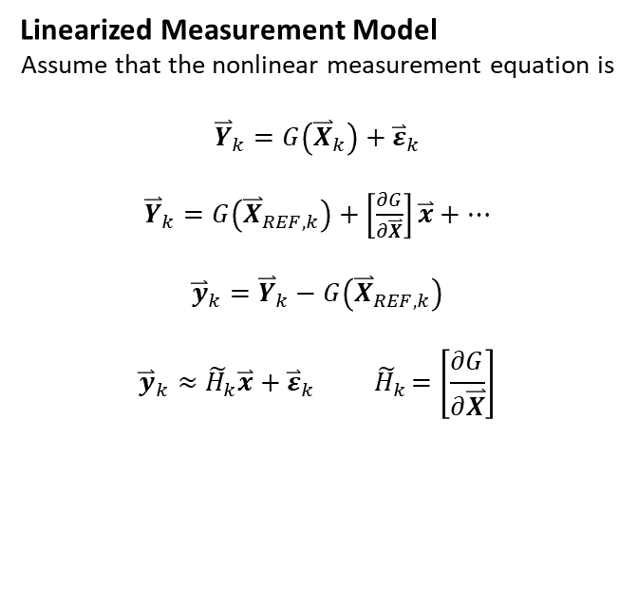
Measurement Model
We can apply the same concept to linearize the measurement equations.
Linearized Measurement Model
Assume that the nonlinear measurement equation is
$${\overset{⃑}{Y}}_{k}=G\left({\overset{⃑}{X}}_{k}\right)+{\overset{⃑}{ε}}_{k}$$
${\overset{⃑}{Y}}_{k}=G\left({\overset{⃑}{X}}_{REF,k}\right)+$ $\left[\frac{∂G}{∂\overset{⃑}{X}}\right]\overset{⃑}{x}+…$
$${\overset{⃑}{y}}_{k}={\overset{⃑}{Y}}_{k}−G\left({\overset{⃑}{X}}_{REF,k}\right)$$
$${\overset{⃑}{y}}_{k}≈{\tilde{H}}_{k}\overset{⃑}{x}+{\overset{⃑}{ε}}_{k}{ \tilde{H}}_{k}=\left[\frac{∂G}{∂\overset{⃑}{X}}\right]$$

Slide 9
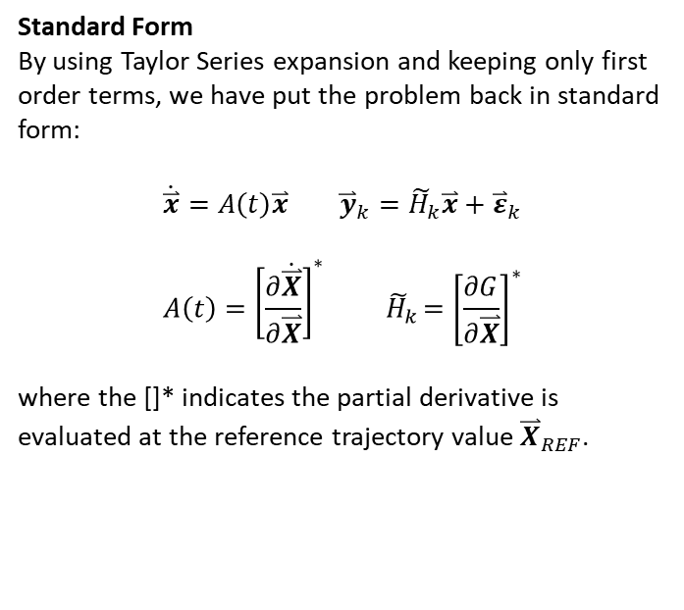
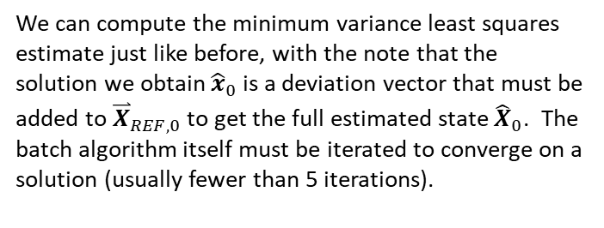
Linearized Orbit Determination Model
Standard Form
By using Taylor Series expansion and keeping only first order terms, we have put the problem back in standard form:
$$\dot{\overset{⃑}{x}}=A\left(t\right)\overset{⃑}{x} {\overset{⃑}{y}}_{k}={\tilde{H}}_{k}\overset{⃑}{x}+{\overset{⃑}{ε}}_{k}$$
$$A\left(t\right)={\left[\frac{∂\dot{\overset{⃑}{X}}}{∂\overset{⃑}{X}}\right]}^{∗}{ \tilde{H}}_{k}={\left[\frac{∂G}{∂\overset{⃑}{X}}\right]}^{∗}$$
where the []* indicates the partial derivative is evaluated at the reference trajectory value ${\overset{⃑}{X}}_{REF}$.
We can compute the minimum variance least squares estimate just like before, with the note that the solution we obtain ${\hat{x}}_{0}$ is a deviation vector that must be added to ${\overset{⃑}{X}}_{REF,0}$ to get the full estimated state ${\hat{X}}_{0}$. The batch algorithm itself must be iterated to converge on a solution (usually fewer than 5 iterations).

Slide 10
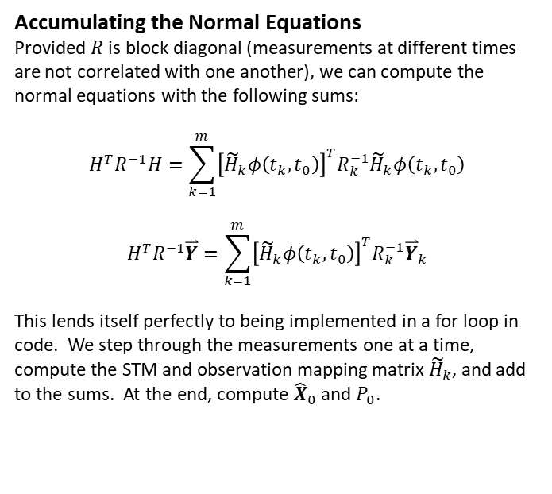
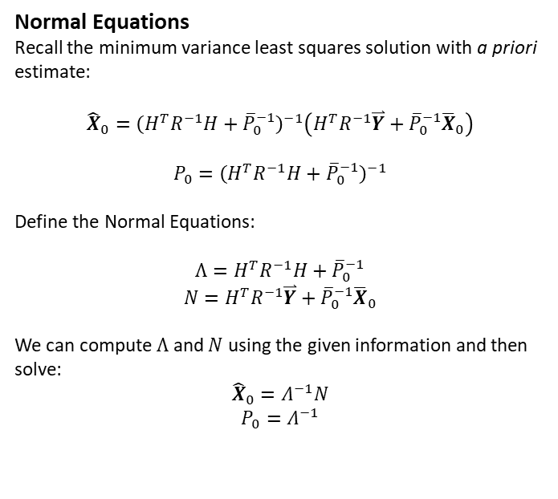
Least Squares Solution
Normal Equations
Recall the minimum variance least squares solution with a priori estimate:
$${\hat{X}}_{0}={\left(H^{T}R^{−1}H+{\overline{P}}_{0}^{−1}\right)}^{−1}\left(H^{T}R^{−1}\overset{⃑}{Y}+{\overline{P}}_{0}^{−1}{\overline{X}}_{0}\right)$$
$${P_{0}=\left(H^{T}R^{−1}H+{\overline{P}}_{0}^{−1}\right)}^{−1}$$
Define the Normal Equations:
$$Λ=H^{T}R^{−1}H+{\overline{P}}_{0}^{−1}$$
$$N=H^{T}R^{−1}\overset{⃑}{Y}+{\overline{P}}_{0}^{−1}{\overline{X}}_{0}$$
We can compute $Λ$ and $N$ using the given information and then solve:
$${\hat{X}}_{0}=Λ^{−1}N$$
$$P_{0}=Λ^{−1}$$
Accumulating the Normal Equations
Provided $R$ is block diagonal (measurements at different times are not correlated with one another), we can compute the normal equations with the following sums:
$$H^{T}R^{−1}H=\sum_{k=1}^{m}{{\left[{\tilde{H}}_{k}φ\left(t_{k},t_{0}\right)\right]}^{T}R_{k}^{−1}{\tilde{H}}_{k}φ\left(t_{k},t_{0}\right)}$$
$$H^{T}R^{−1}\overset{⃑}{Y}=\sum_{k=1}^{m}{{\left[{\tilde{H}}_{k}φ\left(t_{k},t_{0}\right)\right]}^{T}R_{k}^{−1}{\overset{⃑}{Y}}_{k}}$$
This lends itself perfectly to being implemented in a for loop in code. We step through the measurements one at a time, compute the STM and observation mapping matrix ${\tilde{H}}_{k}$, and add to the sums. At the end, compute ${\hat{X}}_{0}$ and $P_{0}$.

Slide 11
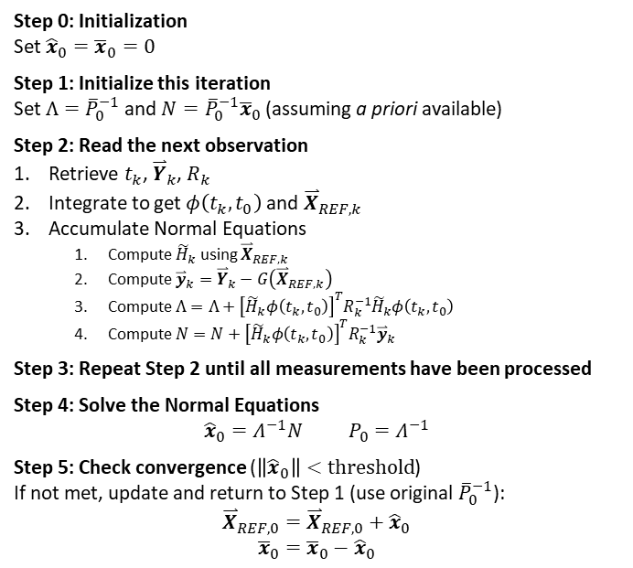
Batch Processing Algorithm (Nonlinear OD)
Finally we have the nonlinear batch processing algorithm, suitable for use in orbit determination. The method processes a batch of measurements simultaneously to produce the best estimate of the state deviation vector and its associated covariance (uncertainty) at the initial epoch. The state deviation vector can be added to the reference trajectory to get the full estimated state at the initial epoch.
The nonlinear batch algorithm must be iterated to converge on the state deviation (when this value goes to zero it means our reference trajectory is now basically our solution). The initial guess at the reference trajectory must be somewhat close to the truth in order for the method to converge.
Step 0: Initialization
Set ${\hat{x}}_{0}={\overline{x}}_{0}=0$
Step 1: Initialize this iteration
Set $Λ={\overline{P}}_{0}^{−1}$ and ${N=\overline{P}}_{0}^{−1}{\overline{x}}_{0}$ (assuming a priori available)
Step 2: Read the next observation
Retrieve $t_{k}$, ${\overset{⃑}{Y}}_{k}$, $R_{k}$
Integrate to get $φ\left(t_{k},t_{0}\right)$ and ${\overset{⃑}{X}}_{REF,k}$
Accumulate Normal Equations
Compute ${\tilde{H}}_{k}$ using ${\overset{⃑}{X}}_{REF,k}$
Compute ${\overset{⃑}{y}}_{k}={\overset{⃑}{Y}}_{k}−G\left({\overset{⃑}{X}}_{REF,k}\right)$
Compute $Λ=Λ+{\left[{\tilde{H}}_{k}φ\left(t_{k},t_{0}\right)\right]}^{T}R_{k}^{−1}{\tilde{H}}_{k}φ\left(t_{k},t_{0}\right)$
Compute $N=N+{\left[{\tilde{H}}_{k}φ\left(t_{k},t_{0}\right)\right]}^{T}R_{k}^{−1}{\overset{⃑}{y}}_{k}$
Step 3: Repeat Step 2 until all measurements have been processed
Step 4: Solve the Normal Equations
$${\hat{x}}_{0}=Λ^{−1}N P_{0}=Λ^{−1}$$
Step 5: Check convergence ($\left\|{\hat{x}}_{0}\right\|<threshold$)
If not met, update and return to Step 1 (use original ${\overline{P}}_{0}^{−1}$):
$${\overset{⃑}{X}}_{REF,0}={\overset{⃑}{X}}_{REF,0}+{\hat{x}}_{0}$$
$${\overline{x}}_{0}={\overline{x}}_{0}−{\hat{x}}_{0}$$

Slide 12
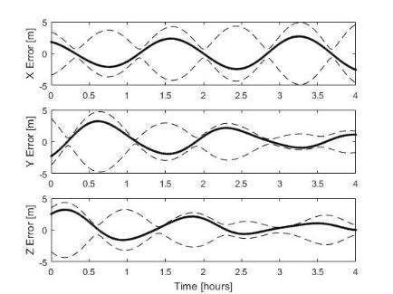
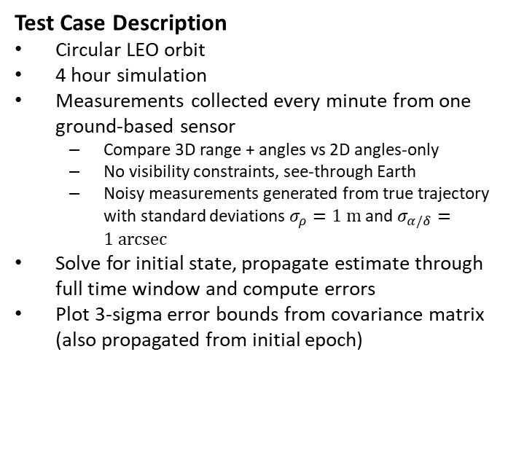
Batch OD Example
Test Case Description
Circular LEO orbit
4 hour simulation
Measurements collected every minute from one ground-based sensor
Compare 3D range + angles vs 2D angles-only
No visibility constraints, see-through Earth
Noisy measurements generated from true trajectory with standard deviations $σ_{ρ}=1 m$ and $σ_{α/δ}=1 arcsec$
Solve for initial state, propagate estimate through full time window and compute errors
Plot 3-sigma error bounds from covariance matrix (also propagated from initial epoch)

Slide 13
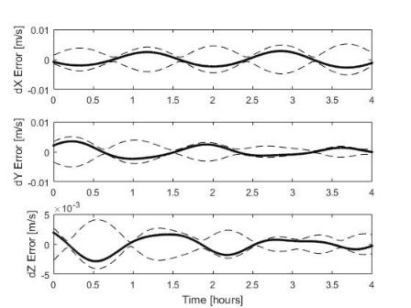
Batch OD Results – 3D Measurements

Slide 14
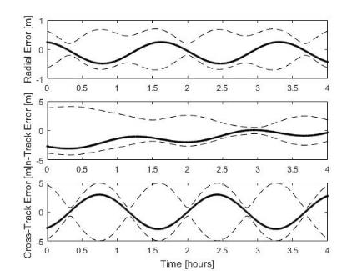
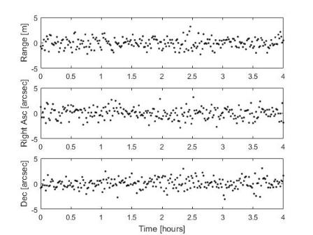
Batch OD Results – 3D Measurements

Slide 15
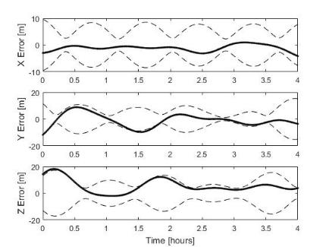
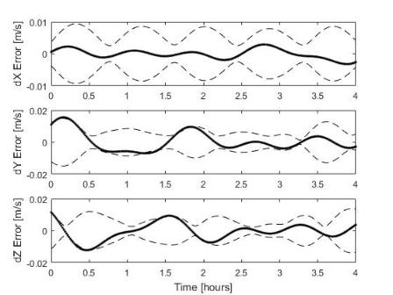
Batch OD Results – 2D Measurements

Slide 16
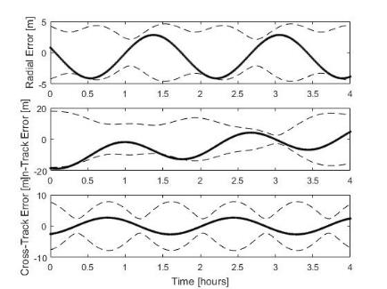
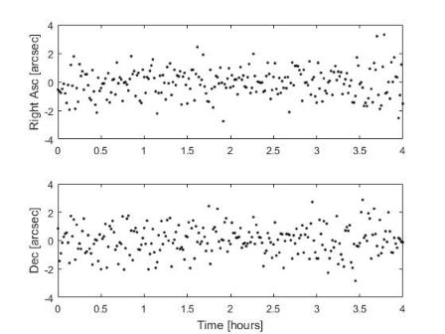
Batch OD Results – 2D Measurements

Slide 17
Orbit Determination Batch Summary
We can solve nonlinear orbit determination problem using linear Batch Least Squares by applying Taylor Series to linearize the problem and put it in standard form
We use a measurement deviation vector (residuals) to update the state deviation vector, which we add to a reference trajectory to get the full estimated state vector
Have to iterate solution to converge
Only works if reference trajectory is close enough to truth that linear approximation is valid (radius of convergence), otherwise solutions will diverge
Not great for long data gaps, or long arcs in general (several days) in this case may be best to break data up in shorter segments and patch solutions together or process data in sliding window
Does not address Non-Gaussian uncertainty which is an issue for nonlinear problems in general and OD in particular

Slide 18
Batch vs Sequential Estimation

Slide 19
Batch vs Sequential
Drawbacks of Batch Estimation
One of the main drawbacks of the batch estimator is that it is not easy to incorporate new measurements, we have to process everything together. Suppose we have a nonlinear OD solution using 100 measurements. If we collect 1 new measurement, our batch estimate requires running the whole processor again, for 101 measurements, iterating several times to convergence. This is computationally expensive, and not ideal for real-time estimation.
Philosophy of Sequential Estimation
It is also unnecessary. The statistical behavior of a random vector (in this case the object’s estimated state vector) is completely described by the PDF. In particular, the Gaussian PDF is completely characterized by the mean and covariance. If we process a set of measurements to produce an estimated mean and covariance at a given time, the information in those measurements is now contained in those estimated quantities. We should be able to process a single new measurement and update the mean and covariance without having to process all the previous measurements again.

Slide 20
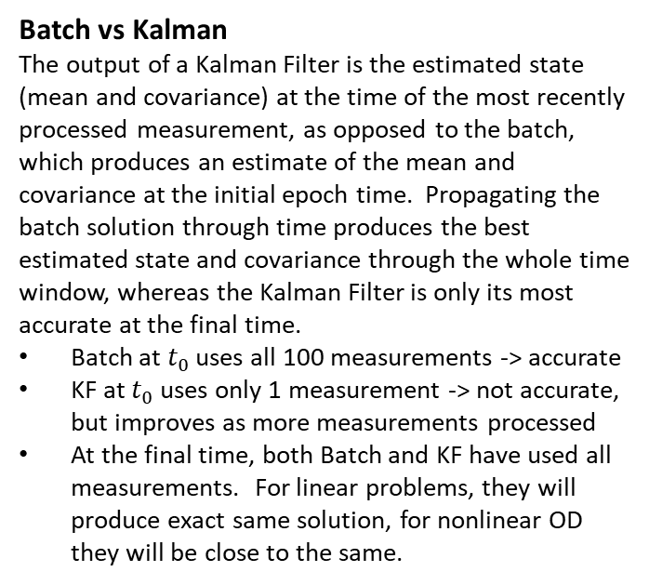
Sequential Estimation
Kalman Filter
This argument led to the development of sequential estimation, the most famous example of which is the Kalman Filter (1960). The Kalman Filter is just a reorganization of the batch estimator, still based on minimizing the least squares cost function, that is focused on processing measurements one at a time to update a given mean and covariance. The algorithm is more computationally efficient by virtue of processing a single measurement as opposed to a batch, doesn’t require iteration (though people do iterate to improve performance), doesn’t require large matrix inverses, etc.
Batch vs Kalman
The output of a Kalman Filter is the estimated state (mean and covariance) at the time of the most recently processed measurement, as opposed to the batch, which produces an estimate of the mean and covariance at the initial epoch time. Propagating the batch solution through time produces the best estimated state and covariance through the whole time window, whereas the Kalman Filter is only its most accurate at the final time.
Batch at $t_{0}$ uses all 100 measurements -> accurate
KF at $t_{0}$ uses only 1 measurement -> not accurate, but improves as more measurements processed
At the final time, both Batch and KF have used all measurements. For linear problems, they will produce exact same solution, for nonlinear OD they will be close to the same.

Slide 21
Sequential Estimation
Real-Time Estimation
For these reasons, the Kalman Filter is generally considered best for real-time estimation. It is computationally efficient, easy to incorporate new measurements as they come in, and for a given measurement set it is about as accurate at the final time as a batch solution processing all the measurements together. Batch is generally used for post-processing data as it will produce the most accurate solution over the whole window. Also, real-time filtering is done onboard satellites where computing power and time are at a premium, post-processing is done on the ground where arbitrary computing power is available.
Real-World Examples
Kalman Filtering was used for the Apollo 11 moon landing, on the lunar module. It also forms the basis for multitarget estimation used in SSA which we will discuss later in the semester.
Intuition
I have always felt that Kalman Filtering is conceptually more intuitive than batch estimation. Most of our remaining lectures will involve discussing variations of the KF designed to deal with specific challenges posed by orbit determination of a large catalog of space objects (dynamic model errors, non-Gaussian uncertainty, object characterization, maneuver detection, …)

Slide 22
Nomenclature
Filter
Formally, the term filter implies a sequential estimator, so you should not say “batch filter”
Estimator
It is always acceptable to say estimator – batch estimator or sequential estimator are both fine
Processor
Another common term for batch estimator is batch processor
Acceptable
Batch estimator, batch processor, batch, least squares batch
Sequential estimator, sequential filter, Kalman filter

Slide 23
Conventional Kalman Filter

Slide 24
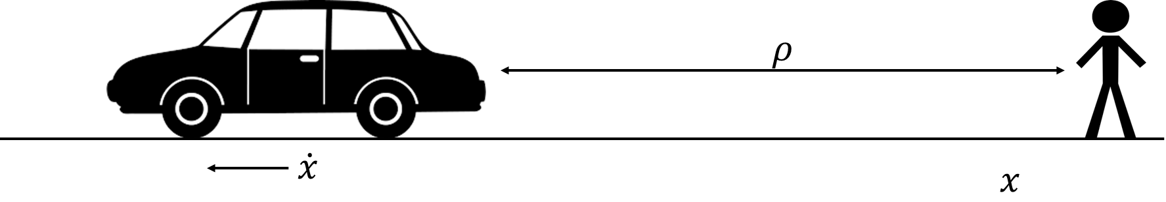
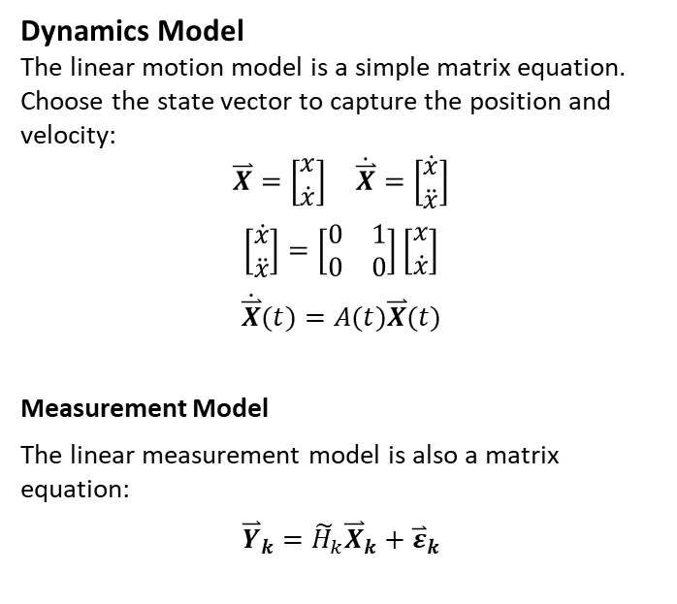

Linear Motion Model
Problem Statement
Consider a simple example involving linear motion. Your friend is driving his car down a straight road at constant velocity. You periodically take range measurements using a laser with Gaussian-distributed noise such that $σ_{ρ}=0.5 m$. How do you determine where the car is over time?
Dynamics Model
The linear motion model is a simple matrix equation. Choose the state vector to capture the position and velocity:
$$\overset{⃑}{X}=\left[\begin{matrix}x \\ \dot{x}\end{matrix}\right] \dot{\overset{⃑}{X}}=\left[\begin{matrix}\dot{x} \\ \ddot{x}\end{matrix}\right]$$
$$\left[\begin{matrix}\dot{x} \\ \ddot{x}\end{matrix}\right]=\left[\begin{matrix}0 & 1 \\ 0 & 0\end{matrix}\right]\left[\begin{matrix}x \\ \dot{x}\end{matrix}\right]$$
$$\dot{\overset{⃑}{X}}(t)=A(t)\overset{⃑}{X}(t)$$
Measurement Model
The linear measurement model is also a matrix equation:
$${\overset{⃑}{Y}}_{k}={\tilde{H}}_{k}{\overset{⃑}{X}}_{k}+{\overset{⃑}{ε}}_{k}$$

Slide 25
Kalman Filter
The Kalman Filter is a recursive two-step process.
Predictor
Using the equations of motion (dynamics), map the estimated state and uncertainty to a future time at which we have a measurement.
Corrector
Use the measurement equation and a least squares fit to update the current estimated state and uncertainty.
The process is repeated for all available measurements.

Slide 26
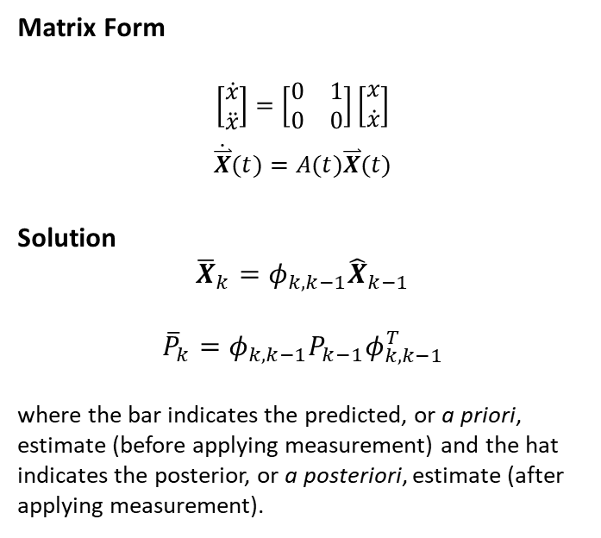
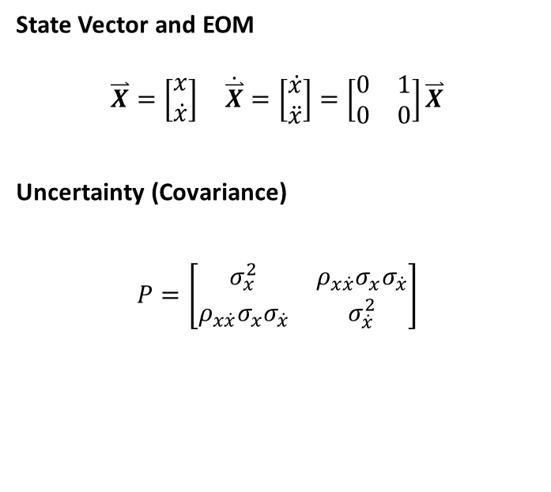
Kalman Filter Predictor
State Vector and EOM
$$\overset{⃑}{X}=\left[\begin{matrix}x \\ \dot{x}\end{matrix}\right] \dot{\overset{⃑}{X}}=\left[\begin{matrix}\dot{x} \\ \ddot{x}\end{matrix}\right]=\left[\begin{matrix}0 & 1 \\ 0 & 0\end{matrix}\right]\overset{⃑}{X}$$
Uncertainty (Covariance)
$$P=\left[\begin{matrix}σ_{x}^{2} & ρ_{x\dot{x}}σ_{x}σ_{\dot{x}} \\ ρ_{x\dot{x}}σ_{x}σ_{\dot{x}} & σ_{\dot{x}}^{2}\end{matrix}\right]$$
Matrix Form
$$\left[\begin{matrix}\dot{x} \\ \ddot{x}\end{matrix}\right]=\left[\begin{matrix}0 & 1 \\ 0 & 0\end{matrix}\right]\left[\begin{matrix}x \\ \dot{x}\end{matrix}\right]$$
$$\dot{\overset{⃑}{X}}(t)=A(t)\overset{⃑}{X}(t)$$
Solution
$${\overline{X}}_{k}=φ_{k,k−1}{\hat{X}}_{k−1}$$
$${\overline{P}}_{k}=φ_{k,k−1}P_{k−1}φ_{k,k−1}^{T}$$
where the bar indicates the predicted, or a priori, estimate (before applying measurement) and the hat indicates the posterior, or a posteriori, estimate (after applying measurement).

Slide 27
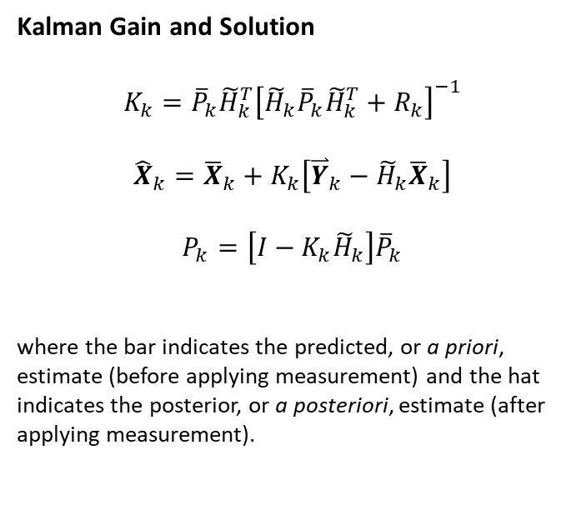
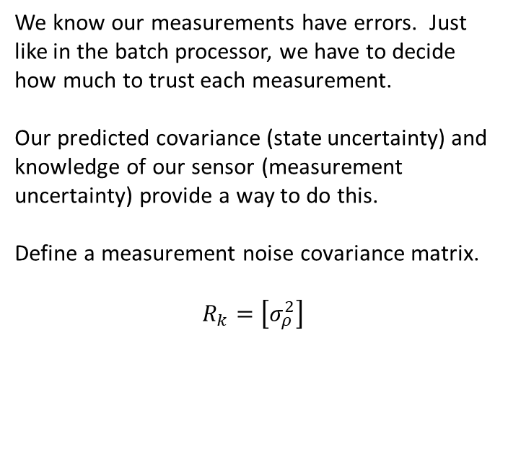
Kalman Filter Corrector
We know our measurements have errors. Just like in the batch processor, we have to decide how much to trust each measurement.
Our predicted covariance (state uncertainty) and knowledge of our sensor (measurement uncertainty) provide a way to do this.
Define a measurement noise covariance matrix.
$$R_{k}=\left[σ_{ρ}^{2}\right]$$
Kalman Gain and Solution
$$K_{k}={\overline{P}}_{k}{\tilde{H}}_{k}^{T}{\left[{\tilde{H}}_{k}{\overline{P}}_{k}{\tilde{H}}_{k}^{T}+R_{k}\right]}^{−1}$$
$${\hat{X}}_{k}={\overline{X}}_{k}+K_{k}\left[{\overset{⃑}{Y}}_{k}−{\tilde{H}}_{k}{\overline{X}}_{k}\right]$$
$$P_{k}=\left[I−K_{k}{\tilde{H}}_{k}\right]{\overline{P}}_{k}$$
where the bar indicates the predicted, or a priori, estimate (before applying measurement) and the hat indicates the posterior, or a posteriori, estimate (after applying measurement).

Slide 28
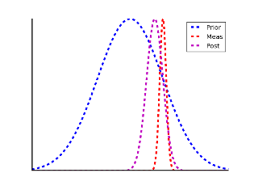
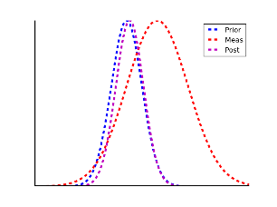
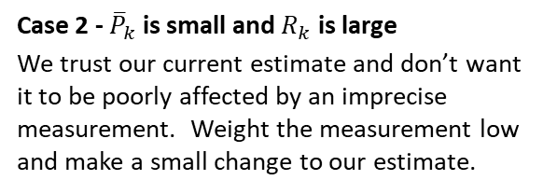
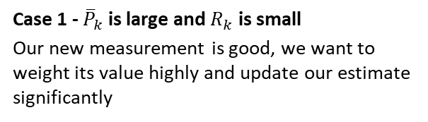
Quantifying Trust – Kalman Gain
Case 1 - ${\overline{P}}_{k}$ is large and $R_{k}$ is small
Our new measurement is good, we want to weight its value highly and update our estimate significantly
Case 2 - ${\overline{P}}_{k}$ is small and $R_{k}$ is large
We trust our current estimate and don’t want it to be poorly affected by an imprecise measurement. Weight the measurement low and make a small change to our estimate.
$$K_{k}={\overline{P}}_{k}{\tilde{H}}_{k}^{T}{\left[{\tilde{H}}_{k}{\overline{P}}_{k}{\tilde{H}}_{k}^{T}+R_{k}\right]}^{−1} {\hat{X}}_{k}={\overline{X}}_{k}+K_{k}\left[{\overset{⃑}{Y}}_{k}−{\tilde{H}}_{k}{\overline{X}}_{k}\right] P_{k}=\left[I−K_{k}{\tilde{H}}_{k}\right]{\overline{P}}_{k}$$

Slide 29
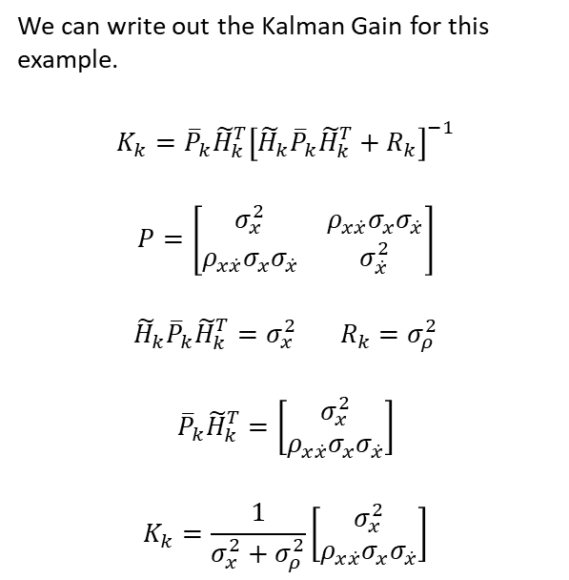
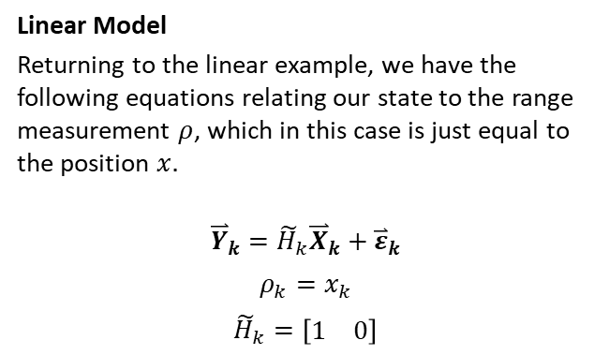
Quantifying Trust – Kalman Gain
Linear Model
Returning to the linear example, we have the following equations relating our state to the range measurement $ρ$, which in this case is just equal to the position $x.$
$${\overset{⃑}{Y}}_{k}={\tilde{H}}_{k}{\overset{⃑}{X}}_{k}+{\overset{⃑}{ε}}_{k}$$
$$ρ_{k}=x_{k}$$
$${\tilde{H}}_{k}=\left[\begin{matrix}1 & 0\end{matrix}\right]$$
We can write out the Kalman Gain for this example.
$$K_{k}={\overline{P}}_{k}{\tilde{H}}_{k}^{T}{\left[{\tilde{H}}_{k}{\overline{P}}_{k}{\tilde{H}}_{k}^{T}+R_{k}\right]}^{−1}$$
$$P=\left[\begin{matrix}σ_{x}^{2} & ρ_{x\dot{x}}σ_{x}σ_{\dot{x}} \\ ρ_{x\dot{x}}σ_{x}σ_{\dot{x}} & σ_{\dot{x}}^{2}\end{matrix}\right]$$
$${\tilde{H}}_{k}{\overline{P}}_{k}{\tilde{H}}_{k}^{T}=σ_{x}^{2} R_{k}=σ_{ρ}^{2}$$
$${\overline{P}}_{k}{\tilde{H}}_{k}^{T}=\left[\begin{matrix}σ_{x}^{2} \\ ρ_{x\dot{x}}σ_{x}σ_{\dot{x}}\end{matrix}\right]$$
$$K_{k}=\frac{1}{σ_{x}^{2}+σ_{ρ}^{2}}\left[\begin{matrix}σ_{x}^{2} \\ ρ_{x\dot{x}}σ_{x}σ_{\dot{x}}\end{matrix}\right]$$
What is the significance of the cross-correlation term?

Slide 30
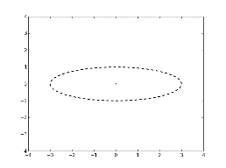
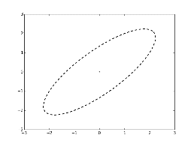
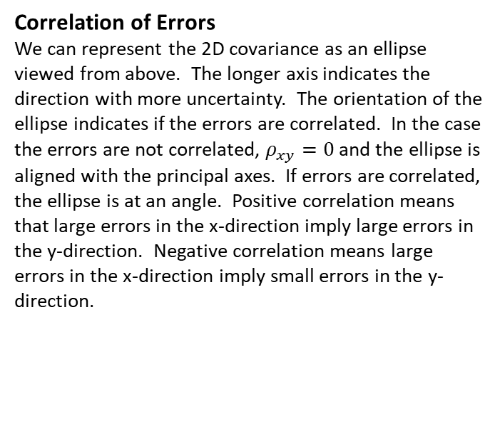
Multivariate Gaussian Distribution
Correlation of Errors
We can represent the 2D covariance as an ellipse viewed from above. The longer axis indicates the direction with more uncertainty. The orientation of the ellipse indicates if the errors are correlated. In the case the errors are not correlated, $ρ_{xy}=0$ and the ellipse is aligned with the principal axes. If errors are correlated, the ellipse is at an angle. Positive correlation means that large errors in the x-direction imply large errors in the y-direction. Negative correlation means large errors in the x-direction imply small errors in the y-direction.
Uncorrelated
Positively Correlated

Slide 31
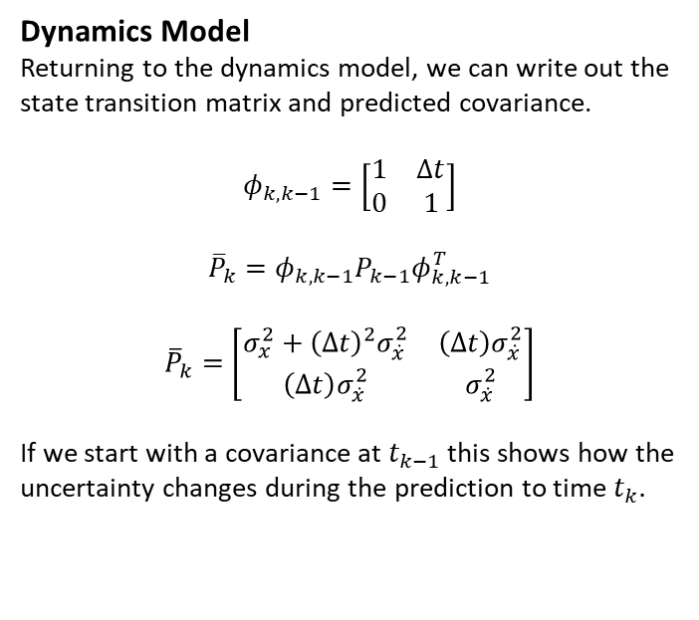
Correlation of Position and Velocity
Dynamics Model
Returning to the dynamics model, we can write out the state transition matrix and predicted covariance.
$$φ_{k,k−1}=\left[\begin{matrix}1 & Δt \\ 0 & 1\end{matrix}\right]$$
$${\overline{P}}_{k}=φ_{k,k−1}P_{k−1}φ_{k,k−1}^{T}$$
$${\overline{P}}_{k}=\left[\begin{matrix}σ_{x}^{2}+{\left(Δt\right)}^{2}σ_{\dot{x}}^{2} & \left(Δt\right)σ_{\dot{x}}^{2} \\ \left(Δt\right)σ_{\dot{x}}^{2} & σ_{\dot{x}}^{2}\end{matrix}\right]$$
If we start with a covariance at $t_{k−1}$ this shows how the uncertainty changes during the prediction to time $t_{k}.$
Correlated Errors
Because the off-diagonal terms are non-zero, we know that the position and velocity errors will be correlated. We can also see that the magnitude of this correlation is a function of the time interval. This fits our understanding of the physics – large errors in velocity imply large errors in position, and will scale with the amount of time between measurements. This also has an important implication for our current example.

Slide 32
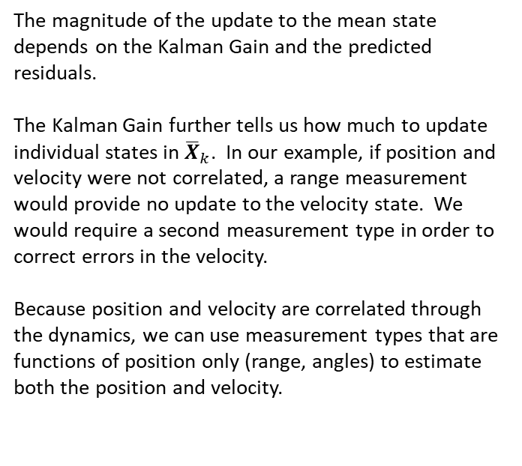
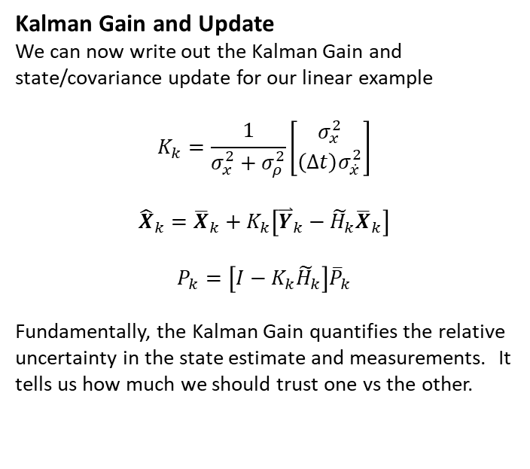
Kalman Filter Corrector Summary
Kalman Gain and Update
We can now write out the Kalman Gain and state/covariance update for our linear example
$$K_{k}=\frac{1}{σ_{x}^{2}+σ_{ρ}^{2}}\left[\begin{matrix}σ_{x}^{2} \\ \left(Δt\right)σ_{\dot{x}}^{2}\end{matrix}\right]$$
$${\hat{X}}_{k}={\overline{X}}_{k}+K_{k}\left[{\overset{⃑}{Y}}_{k}−{\tilde{H}}_{k}{\overline{X}}_{k}\right]$$
$$P_{k}=\left[I−K_{k}{\tilde{H}}_{k}\right]{\overline{P}}_{k}$$
Fundamentally, the Kalman Gain quantifies the relative uncertainty in the state estimate and measurements. It tells us how much we should trust one vs the other.
The magnitude of the update to the mean state depends on the Kalman Gain and the predicted residuals.
The Kalman Gain further tells us how much to update individual states in ${\overline{X}}_{k}$. In our example, if position and velocity were not correlated, a range measurement would provide no update to the velocity state. We would require a second measurement type in order to correct errors in the velocity.
Because position and velocity are correlated through the dynamics, we can use measurement types that are functions of position only (range, angles) to estimate both the position and velocity.

Slide 33
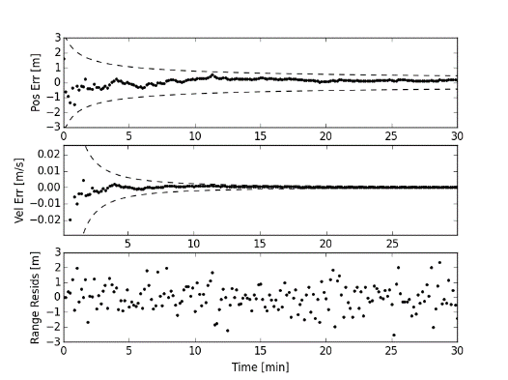
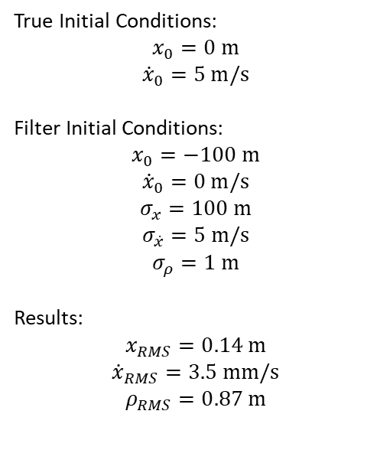
Linear Example Results
True Initial Conditions:
$$x_{0}=0 m$$
$${\dot{x}}_{0}=5 m/s$$
Filter Initial Conditions:
$$x_{0}=−100 m$$
$${\dot{x}}_{0}=0 m/s$$
$$σ_{x}=100 m$$
$$σ_{\dot{x}}=5 m/s$$
$$σ_{ρ}=1 m$$
Results:
$$x_{RMS}=0.14 m$$
$${\dot{x}}_{RMS}=3.5 mm/s$$
$$ρ_{RMS}=0.87 m$$

Slide 34
Orbit Model

Slide 35
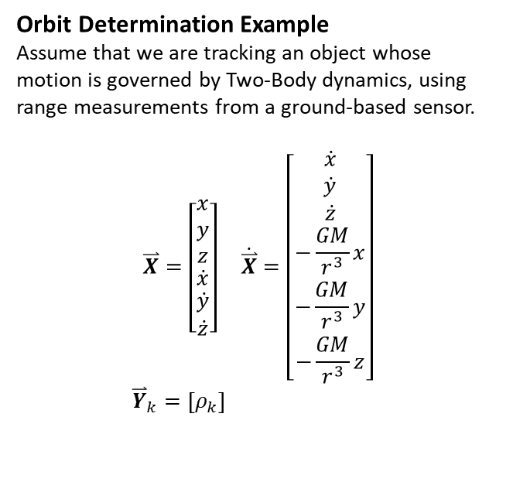
Orbit Determination Problem
The key challenge posed by applying least squares estimation to orbit determination is that both the dynamics and measurement equations are nonlinear. CKF is designed for linear systems, so we will have to make some adjustments.
Orbit Determination Example
Assume that we are tracking an object whose motion is governed by Two-Body dynamics, using range measurements from a ground-based sensor.
$$\overset{⃑}{X}=\left[\begin{matrix}\begin{matrix}x \\ y \\ z\end{matrix} \\ \dot{x} \\ \begin{matrix}\dot{y} \\ \dot{z}\end{matrix}\end{matrix}\right] \dot{\overset{⃑}{X}}=\left[\begin{matrix}\begin{matrix}\dot{x} \\ \dot{y} \\ \dot{z}\end{matrix} \\ −\frac{GM}{r^{3}}x \\ \begin{matrix}−\frac{GM}{r^{3}}y \\ −\frac{GM}{r^{3}}z\end{matrix}\end{matrix}\right]$$
${\overset{⃑}{Y}}_{k}=\left[ρ_{k}\right]$

Slide 36
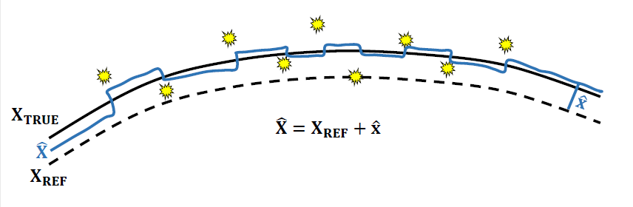
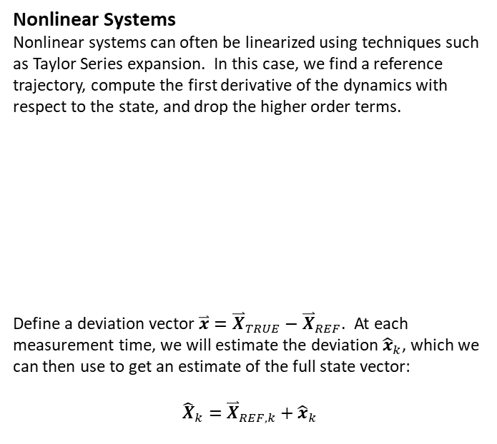
Dynamics Model
Nonlinear Systems
Nonlinear systems can often be linearized using techniques such as Taylor Series expansion. In this case, we find a reference trajectory, compute the first derivative of the dynamics with respect to the state, and drop the higher order terms.
Define a deviation vector $\overset{⃑}{x}={\overset{⃑}{X}}_{TRUE}−{\overset{⃑}{X}}_{REF}$. At each measurement time, we will estimate the deviation ${\hat{x}}_{k}$, which we can then use to get an estimate of the full state vector:
$${\hat{X}}_{k}={\overset{⃑}{X}}_{REF,k}+{\hat{x}}_{k}$$
Linearized System
The Taylor Series can be written out as
$${\dot{\overset{⃑}{X}}}_{TRUE}={\dot{\overset{⃑}{X}}}_{REF}+\left[\frac{∂\dot{\overset{⃑}{X}}}{∂\overset{⃑}{X}}\right]\overset{⃑}{x}+\frac{1}{2}\left[\frac{∂^{2}\dot{\overset{⃑}{X}}}{∂{\overset{⃑}{X}}^{2}}\right]{\overset{⃑}{x}}^{2}+…$$
Keeping only the linear terms yields
$${\dot{\overset{⃑}{X}}}_{TRUE}−{\dot{\overset{⃑}{X}}}_{REF}≈\left[\frac{∂\dot{\overset{⃑}{X}}}{∂\overset{⃑}{X}}\right]\overset{⃑}{x}$$
$$\dot{\overset{⃑}{x}}≈\left[\frac{∂\dot{\overset{⃑}{X}}}{∂\overset{⃑}{X}}\right]\overset{⃑}{x}$$
Note that this has the same form as our previous expression for linear dynamics
$$\dot{\overset{⃑}{x}}=A\left(t\right)\overset{⃑}{x} A\left(t\right)=\left[\frac{∂\dot{\overset{⃑}{X}}}{∂\overset{⃑}{X}}\right]$$

Slide 37
Measurement Model
We can apply the same concept to linearize the measurement equations.
Linearized Measurement Model
Assume that the nonlinear measurement equation is
$${\overset{⃑}{Y}}_{k}=G\left({\overset{⃑}{X}}_{k}\right)+{\overset{⃑}{ε}}_{k}$$
${\overset{⃑}{Y}}_{k}=G\left({\overset{⃑}{X}}_{REF,k}\right)+$ $\left[\frac{∂G}{∂\overset{⃑}{X}}\right]\overset{⃑}{x}+…$
$${\overset{⃑}{y}}_{k}={\overset{⃑}{Y}}_{k}−G\left({\overset{⃑}{X}}_{REF,k}\right)$$
$${\overset{⃑}{y}}_{k}≈{\tilde{H}}_{k}\overset{⃑}{x}+{\overset{⃑}{ε}}_{k}{ \tilde{H}}_{k}=\left[\frac{∂G}{∂\overset{⃑}{X}}\right]$$

Slide 38
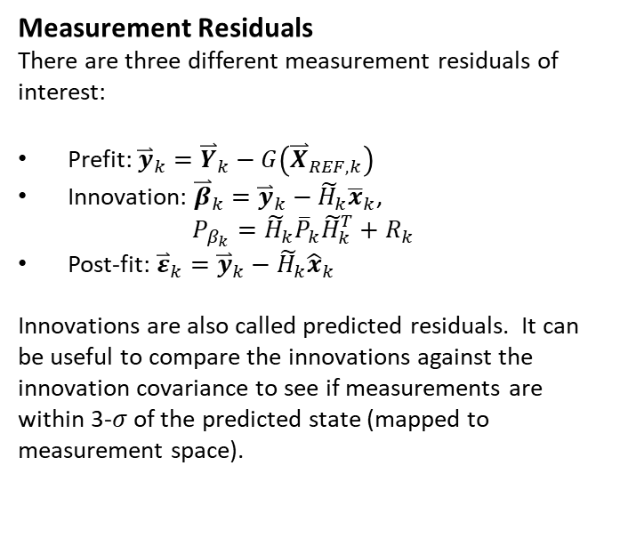
Measurement Model
Measurement Residuals
There are three different measurement residuals of interest:
Prefit: ${\overset{⃑}{y}}_{k}={\overset{⃑}{Y}}_{k}−G\left({\overset{⃑}{X}}_{REF,k}\right)$
Innovation: ${{\overset{⃑}{β}}_{k}={\overset{⃑}{y}}_{k}−\tilde{H}}_{k}{\overline{x}}_{k}$, $P_{β_{k}}={\tilde{H}}_{k}{\overline{P}}_{k}{\tilde{H}}_{k}^{T}+R_{k}$
Post-fit: ${{\overset{⃑}{ε}}_{k}={\overset{⃑}{y}}_{k}−\tilde{H}}_{k}{\hat{x}}_{k}$
Innovations are also called predicted residuals. It can be useful to compare the innovations against the innovation covariance to see if measurements are within 3-$σ$ of the predicted state (mapped to measurement space).
Linearized Measurement Model
Assume that the nonlinear measurement equation is
$${\overset{⃑}{Y}}_{k}=G\left({\overset{⃑}{X}}_{k}\right)+{\overset{⃑}{ε}}_{k}$$
${\overset{⃑}{Y}}_{k}=G\left({\overset{⃑}{X}}_{REF,k}\right)+$ $\left[\frac{∂G}{∂\overset{⃑}{X}}\right]\overset{⃑}{x}+…$
$${\overset{⃑}{y}}_{k}={\overset{⃑}{Y}}_{k}−G\left({\overset{⃑}{X}}_{REF,k}\right)$$
$${\overset{⃑}{y}}_{k}≈{\tilde{H}}_{k}\overset{⃑}{x}+{\overset{⃑}{ε}}_{k}{ \tilde{H}}_{k}=\left[\frac{∂G}{∂\overset{⃑}{X}}\right]$$

Slide 39
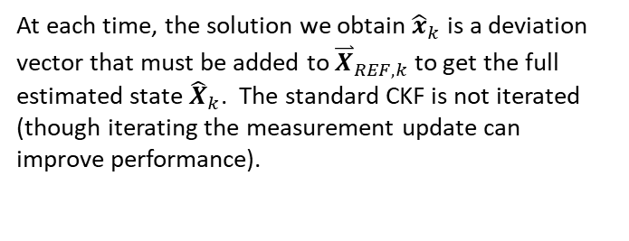
Linearized Orbit Determination Model
Standard Form
By using Taylor Series expansion and keeping only first order terms, we have put the problem back in standard form:
$$\dot{\overset{⃑}{x}}=A\left(t\right)\overset{⃑}{x} {\overset{⃑}{y}}_{k}={\tilde{H}}_{k}\overset{⃑}{x}+{\overset{⃑}{ε}}_{k}$$
$$A\left(t\right)={\left[\frac{∂\dot{\overset{⃑}{X}}}{∂\overset{⃑}{X}}\right]}^{∗}{ \tilde{H}}_{k}={\left[\frac{∂G}{∂\overset{⃑}{X}}\right]}^{∗}$$
where the []* indicates the partial derivative is evaluated at the reference trajectory value ${\overset{⃑}{X}}_{REF}$.
At each time, the solution we obtain ${\hat{x}}_{k}$ is a deviation vector that must be added to ${\overset{⃑}{X}}_{REF,k}$ to get the full estimated state ${\hat{X}}_{k}$. The standard CKF is not iterated (though iterating the measurement update can improve performance).

Slide 40
Batch vs CKF
Batch
Continuous reference trajectory
Solve for deviation at initial epoch
Continuous estimated trajectory
Similar errors throughout full time window
Conventional Kalman Filter
Continuous reference trajectory
Solve for deviation at each measurement time
Discontinuous estimated trajectory (non-physical)
Errors reduce over time as more measurements processed

Slide 41


CKF Algorithm Issues
Filter Saturation
From the equations, we can see that at each time, the measurement update causes the covariance to be reduced by the amount $K_{k}{\tilde{H}}_{k}{\overline{P}}_{k}$:
$$P_{k}=\left[I−K_{k}{\tilde{H}}_{k}\right]{\overline{P}}_{k}$$
Over time, this can cause the state covariance to become very small. This in turn makes the Kalman Gain small:
$$K_{k}={\overline{P}}_{k}{\tilde{H}}_{k}^{T}{\left[{\tilde{H}}_{k}{\overline{P}}_{k}{\tilde{H}}_{k}^{T}+R_{k}\right]}^{−1}$$
The Kalman Gain itself tells us how much to update the state and covariance, as it gets smaller, new measurements have less effect on the estimate.
Eventually, the filter stops “listening” to new measurements because it trusts its state estimate more than any new measurement. We call this condition “filter saturation” or “covariance collapse.” It can be addressed by adding process noise or dynamic model compensation to the predictor step.
Image Credit: Tapley, Schutz, Born

Slide 42


Process Noise
State Noise Compensation (SNC)
Process noise, or SNC, offers a method to keep the covariance from collapsing which ensures the filter continues to apply new measurements to update the state, i.e., the filter does not saturate.
To this point, we have assumed a simplified version of the linear dynamical system model. A more complete version is
$$\dot{\overset{⃑}{x}}(t)=A\left(t\right)\overset{⃑}{x}(t)+B\left(t\right)\overset{⃑}{u}(t)$$
where $\overset{⃑}{u}(t)$ is a vector of control inputs or other accelerations. In the process noise model, we take $\overset{⃑}{u}(t)$ to be a stochastic (random) process, as opposed to deterministic.
CKF Predictor with Process Noise
Specifically, $\overset{⃑}{u}(t)$ is modeled as a white noise (Gaussian) process, with mean 0 and covariance $Q$.
$$\overset{⃑}{u}\left(t\right)\sim N(0,Q)$$
Process noise only affects the predictor step. Specifically, the equations become:
$${\overline{x}}_{k}=φ_{k,k−1}{\hat{x}}_{k−1}+Γ_{k,k−1}\overline{u}$$
where $Γ_{k,k−1}$ is the process noise transition matrix (similar to the STM) and $\overline{u}$ is the mean process noise vector, which we assume to be zero. Therefore, the prediction of the state deviation vector is unaffected:
$${\overline{x}}_{k}=φ_{k,k−1}{\hat{x}}_{k−1}$$

Slide 43


Process Noise
Predicted Covariance
The covariance prediction is affected, however,
$${\overline{P}}_{k}=φ_{k,k−1}P_{k−1}φ_{k,k−1}^{T}+Γ_{k,k−1}Q_{k−1}Γ_{k,k−1}^{T}$$
Process noise therefore has the effect of inflating the predicted covariance without directly changing the mean state estimate. The larger state covariance keeps the filter open to new measurements.
This is important for two reasons. First, if the filter saturates it will stop incorporating new measurements and will likely diverge from the true trajectory over time. Second, if there are any mismodeled accelerations in the dynamics model (e.g. drag), process noise will allow the filter to continue tracking the object despite the modeling error.
Process Noise Covariance and Transition Matrix
The process noise covariance $Q$ is usually set up as a diagonal matrix, with units of acceleration. For the 3D orbit model,
$$Q=\left[\begin{matrix}σ_{\ddot{x}}^{2} & 0 & 0 \\ 0 & σ_{\ddot{y}}^{2} & 0 \\ 0 & 0 & σ_{\ddot{z}}^{2}\end{matrix}\right]$$
The matrix $Γ$ maps from acceleration back to position and velocity
$$Γ=\left[\begin{matrix}\frac{{\left(Δt\right)}^{2}}{2} & 0 & 0 \\ 0 & \frac{{\left(Δt\right)}^{2}}{2} & 0 \\ 0 & 0 & \frac{{\left(Δt\right)}^{2}}{2} \\ Δt & 0 & 0 \\ 0 & Δt & 0 \\ 0 & 0 & Δt\end{matrix}\right]$$

Slide 44

CKF Algorithm Issues
Numerical Issues and Joseph Form
The Kalman filter is subject to numerical issues when implements with the finite precision of a computer (floating point error). This can lead to a non-positive definite covariance matrix. Rather than using the standard equation to update the covariance,
$$P_{k}=\left[I−K_{k}{\tilde{H}}_{k}\right]{\overline{P}}_{k}$$
it is preferred to use the Joseph formulation, which is mathematically equivalent but is guaranteed to be symmetric and improves the numerical performance of the algorithm.
$$P_{k}=\left[I−K_{k}{\tilde{H}}_{k}\right]{\overline{P}}_{k}{\left[I−K_{k}{\tilde{H}}_{k}\right]}^{T}+K_{k}R_{k}K_{k}^{T}$$
Linearization Issues
Just like the batch processor, the CKF is designed for linear problems, and use of the Taylor Series to adapt it for nonlinear problems means our reference trajectory must be “close” to the true trajectory. This limits the length of time over which the filter can be applied, because differences between the true and reference trajectories will grow over time. We will address this using the Extended Kalman Filter (EKF).
Both the batch and CKF assume state errors are Gaussian distributed, which is an assumption that breaks down for nonlinear problems, in particular, for orbit determination in which we sometimes have long gaps between measurements.

Slide 45

CKF Algorithm (Nonlinear OD)
Finally we have the nonlinear CKF algorithm, suitable for use in orbit determination. The method processes a series of measurements sequentially to produce the best estimate of the state deviation vector and its associated covariance (uncertainty) at each measurement epoch. The state deviation vector can be added to the reference trajectory to get the full estimated state at each time.
The nonlinear CKF algorithm does not require iteration, though the initial guess at the reference trajectory must be somewhat close to the truth in order for the method to converge.
Step 1: Initialization
Set ${\overset{⃑}{X}}_{REF,k−1}={\overset{⃑}{X}}_{REF,0}$, ${\hat{x}}_{k−1}={\overline{x}}_{0}$, $P_{k−1}={\overline{P}}_{0}$
Step 2: Read the next observation
Retrieve $t_{k}$, ${\overset{⃑}{Y}}_{k}$, $R_{k}$
Integrate to get $φ_{k,k−1}$and ${\overset{⃑}{X}}_{REF,k}$
Step 3: Predictor (Time Update)
State Dev: ${\overline{x}}_{k}=φ_{k,k−1}{\hat{x}}_{k−1}$
Covar: ${\overline{P}}_{k}=φ_{k,k−1}P_{k−1}φ_{k,k−1}^{T}+Γ_{k,k−1}Q_{k−1}Γ_{k,k−1}^{T}$
Step 4: Corrector (Measurement Update)
Gain: $K_{k}={\overline{P}}_{k}{\tilde{H}}_{k}^{T}{\left[{\tilde{H}}_{k}{\overline{P}}_{k}{\tilde{H}}_{k}^{T}+R_{k}\right]}^{−1}$
State Dev: ${\hat{x}}_{k}={\overline{x}}_{k}+K_{k}\left[{\overset{⃑}{y}}_{k}−{\tilde{H}}_{k}{\overline{x}}_{k}\right]$
State: ${\hat{X}}_{k}={\overset{⃑}{X}}_{REF,k}+{\hat{x}}_{k}$
Covar: $P_{k}=\left[I−K_{k}{\tilde{H}}_{k}\right]{\overline{P}}_{k}{\left[I−K_{k}{\tilde{H}}_{k}\right]}^{T}+K_{k}R_{k}K_{k}^{T}$
Step 5: Repeat Steps 2-4 until all measurements have been processed

Slide 46
Extended Kalman Filter

Slide 47


Extended Kalman Filter
Batch/CKF Shortcoming
The Extended Kalman Filter (EKF) was developed specifically to deal with nonlinear problems, as opposed to the batch and CKF which are linear estimators. As noted, batch and CKF are limited by their use of the first order Taylor Series expansion, which requires the true and reference trajectories to be close enough that the linear approximation remains valid.
In practice, this means the methods are not suitable for long time windows (~days in Earth orbit) because ${\overset{⃑}{X}}_{TRUE}$ and ${\overset{⃑}{X}}_{REF}$ will drift apart, even if they start close together.
EKF Approach
The EKF proposes a fairly simple solution – update the reference trajectory with the best estimated state ${\hat{X}}_{k}$ after each measurement. This ensures ${\overset{⃑}{X}}_{REF}$ stays close to ${\overset{⃑}{X}}_{TRUE}$ provided the estimator is doing its job and producing a good estimate of ${\hat{X}}_{k}.$
Advantages
Extends the usable time window by arbitrary amount – can run the filter indefinitely
Still makes use of Taylor Series expansion so conceptually very similar to CKF
In fact, the EKF can be implemented simply by adding a couple extra lines of code to CKF

Slide 48

CKF vs EKF
Conventional Kalman Filter
Continuous reference trajectory
Solve for deviation at each measurement time
Discontinuous estimated trajectory (non-physical)
Errors reduce over time as more measurements processed
Extended Kalman Filter
Discontinuous reference trajectory
Solve for deviation at each measurement time
Discontinuous estimated trajectory (non-physical)
Update reference trajectory at each measurement time
Errors reduce over time as more measurements processed

Slide 49

EKF Algorithm (Nonlinear OD)
The following summarizes the nonlinear EKF algorithm, suitable for use in orbit determination. The method processes a series of measurements sequentially to produce the best estimate of the state deviation vector and its associated covariance (uncertainty) at each measurement epoch. The state deviation vector can be added to the reference trajectory to get the full estimated state at each time.
The algorithm requires one extra step compared to the CKF to reset the reference trajectory and state deviation vector. At the beginning of the data arc, the estimated state can change dramatically. It is best to run as CKF at first to allow the filter to converge, before applying the EKF update step. It is also good practice to switch back to CKF for a few measurements following long gaps in data.
Step 1: Initialization
Set ${\overset{⃑}{X}}_{REF,k−1}={\overset{⃑}{X}}_{REF,0}$, ${\hat{x}}_{k−1}={\overline{x}}_{0}$, $P_{k−1}={\overline{P}}_{0}$
Step 2: Read the next observation
Retrieve $t_{k}$, ${\overset{⃑}{Y}}_{k}$, $R_{k}$
Integrate to get $φ_{k,k−1}$and ${\overset{⃑}{X}}_{REF,k}$
Step 3: Predictor (Time Update)
State Dev: ${\overline{x}}_{k}=φ_{k,k−1}{\hat{x}}_{k−1}$
Covar: ${\overline{P}}_{k}=φ_{k,k−1}P_{k−1}φ_{k,k−1}^{T}+Γ_{k,k−1}Q_{k−1}Γ_{k,k−1}^{T}$
Step 4: Corrector (Measurement Update)
Gain: $K_{k}={\overline{P}}_{k}{\tilde{H}}_{k}^{T}{\left[{\tilde{H}}_{k}{\overline{P}}_{k}{\tilde{H}}_{k}^{T}+R_{k}\right]}^{−1}$
State Dev: ${\hat{x}}_{k}={\overline{x}}_{k}+K_{k}\left[{\overset{⃑}{y}}_{k}−{\tilde{H}}_{k}{\overline{x}}_{k}\right]$
State: ${\hat{X}}_{k}={\overset{⃑}{X}}_{REF,k}+{\hat{x}}_{k}$
Covar: $P_{k}=\left[I−K_{k}{\tilde{H}}_{k}\right]{\overline{P}}_{k}$ ${\left[I−K_{k}{\tilde{H}}_{k}\right]}^{T}+K_{k}R_{k}K_{k}^{T}$
Step 5: Extended KF Update
If estimate has converged:
Ref: ${\overset{⃑}{X}}_{REF,k}=$ ${\hat{X}}_{k}$
State Dev: ${\hat{x}}_{k}=0$
Step 6: Repeat Steps 2-5 until all measurements have been processed

Slide 50
Summary
CKF and EKF offer efficient, easy way to incorporate measurements as they come in
Good for real-time filtering
KF solution is bad early on, improves over time
Batch and CKF only good for shorter data arcs (~24 hours in Earth orbit). EKF can be used for any length of time because we update the reference trajectory after each measurement which keeps it close to truth.
Process noise makes it easy to account for mismodeled accelerations, harder to do in batch.
All three methods (batch, CKF, EKF) rely on Taylor Series expansion to linearize problem, and assume state errors are Gaussian distributed. We will discuss alternate strategies that are a better fit for nonlinear, non-Gaussian problems like orbit determination in future lectures.

Slide 51
Quiz
Wednesday lecture will start with our first in-class quiz, on object characterization. The objective with these activities is to examine a simplified version of a real-world SSA task. The solutions and approaches you develop for these examples will be extrapolated to discussion of approaches taken in SSA.
For Wednesday, we will look at the case of an object sliding or rolling down a ramp, where an observer has measured the time to reach the bottom, with some unknown errors. This is similar in practice to the task of estimating a space object’s characteristics (size, mass, shape, …)
We will spend the first ~30 minutes on Wednesday working on the example. If you attend in person, there is no need to work on this ahead of time. If you are not able to attend, please work through the exercise before lecture and submit your answers to the discussion topics through moodle. It is not necessary to completely solve the problem, if working at home, please spend about 30 minutes maximum and summarize your findings.
MATLAB code is provided to help work through the problem, you may modify or add anything as you like. Students may work individually or in groups, you may also share information/results as you work through the problem.

Slide 52
Lab Preparation
In Tuesday’s lab session, we will begin processing images collected from the Falcon telescope. Our objective will be to perform orbit determination using the batch processing algorithm, as well as attempting to characterize the objects’ size and spin rate (if spinning).
We will use a software package called AstroImageJ, available from here: https://www.astro.louisville.edu/software/astroimagej/installation_packages/
If you are able, please download and unzip the appropriate zip file (windows, mac, linux) ahead of lab session. You should be able to run AstroImageJ.exe without having to do any other steps, let me know if you have any questions.

